Slide 1


SS 2025 SALES BOOK
This Sales Book include Iittala collection and core line extensions for Spring-Summer 2025

Slide 2
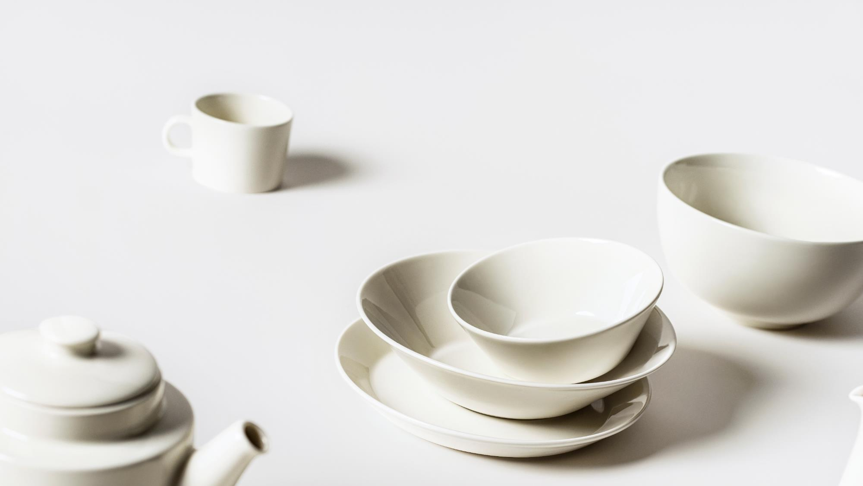

TEEMA

Slide 3
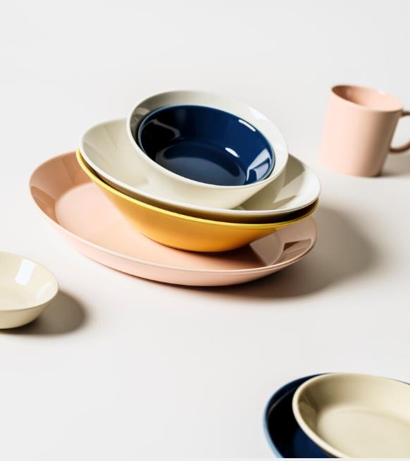
TEEMA
In 1952, Finnish designer Kaj Franck changed our understanding of tableware with the launch of a groundbreaking collection. The designer’s pioneering beliefs in sustainability, equality and moderation fuelled his revolutionary vision.
With the iconic Teema (First introduced as Kilta in 1952. Kilta’s design was revisited and renewed by Franck in 1981 and then re-named Teema), Franck created a collection that embodied his values and set a new standard for tableware. Teema in many ways embodies Franck’s pioneering thoughts about sustainability, equality and moderation. The design’s multifunctionality, simplified forms, combinability and high-quality form a collection which has stood the test of time.
In 2025 Teema range is renewed with a new light lilac colour and celebrated with a spring-summer edition of delicate colours of rose and sage.

Slide 4
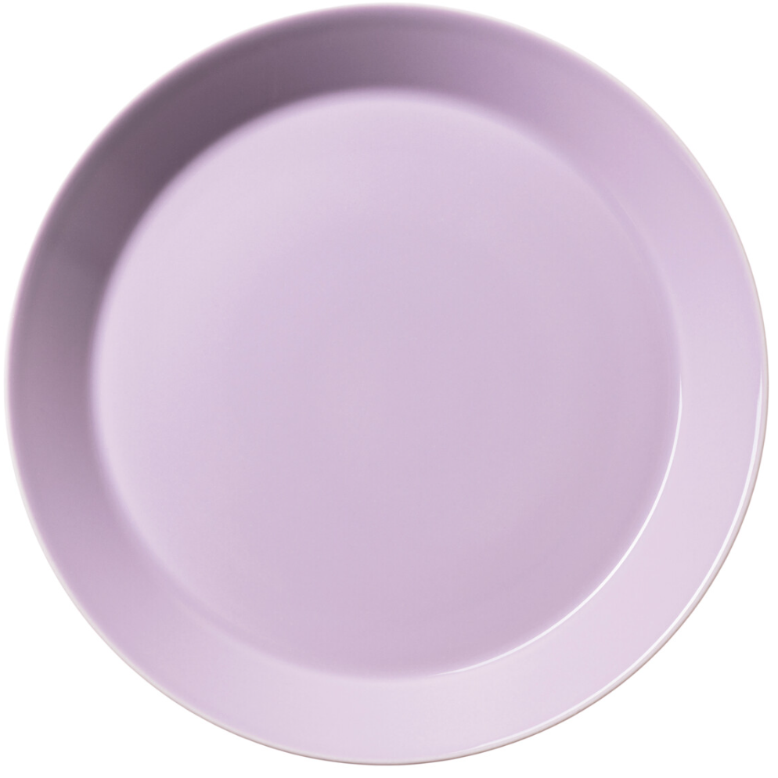
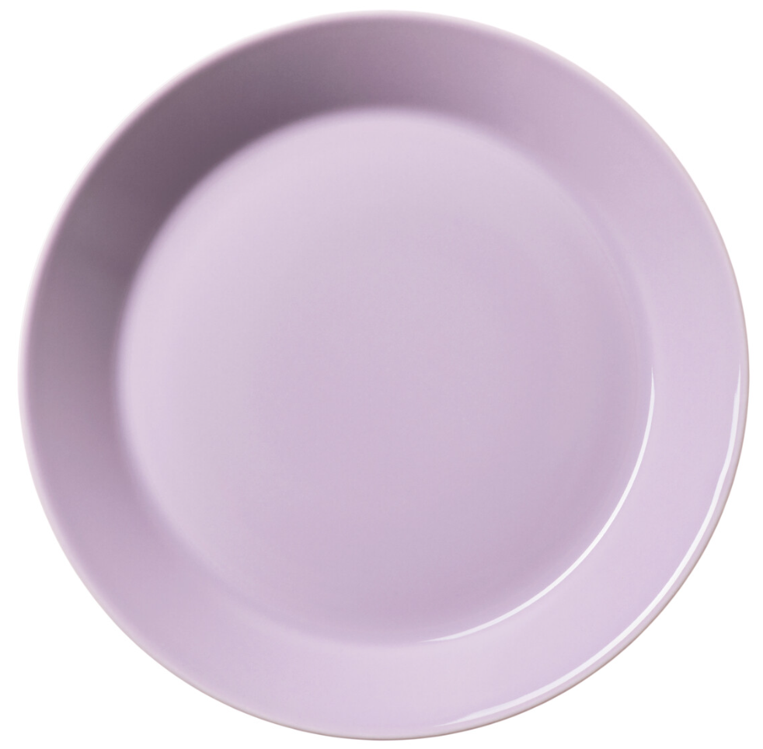
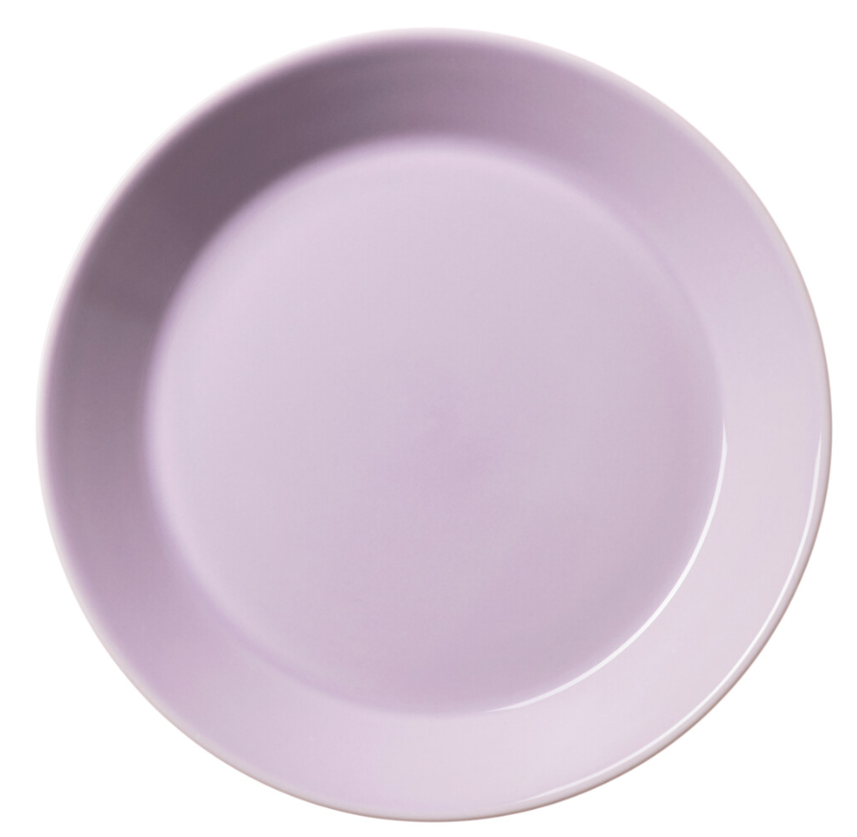
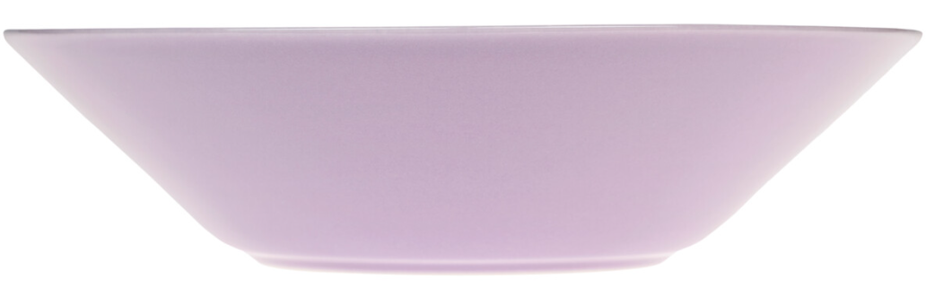
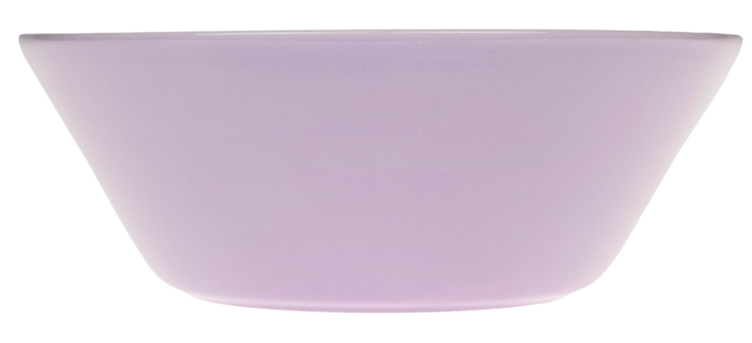
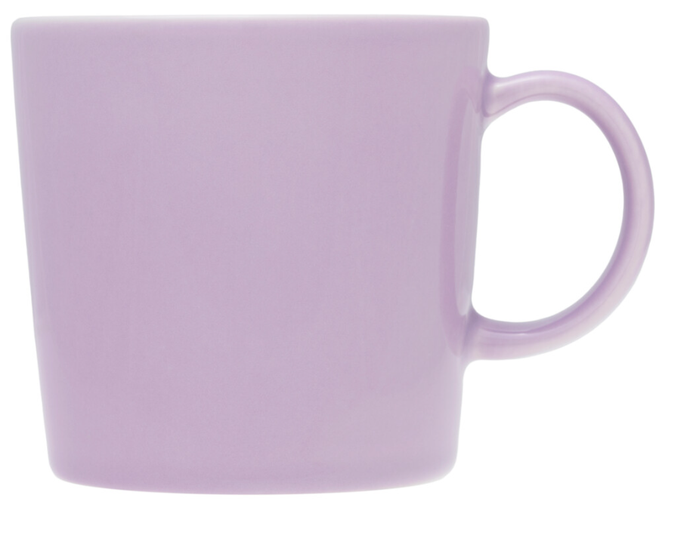
TEEMA light lilac
plate 26cm
plate 21cm
plate 17cm*
plate deep 21cm
bowl 15cm*
mug 0,3L*
Distribution & launch
DTC
All items
DTC Finland & DTC eCom: 13.12.2025
Other DTC 31.1.2025
All items into continuous collection.
Tier 1-3
*Mug 0,3L, bowl 15cm and plate 17cm
7.3.-31.8.2025 as season's edition
Forecast deadline for All markets 2nd of June 2024.
Basic information
Light lilac is new colour
Design by Kaj Franck 1952
Loose items
Dishwasher, microwave, freezer and oven safe
Vitroporcelain
Made in Thailand
Remember this:
The versatile Teema collection offers endless combinations that are both durable and refined. Teema is an iconic representation of minimalist Finnish design.
Light lilac is a new colour to permanent collection. Combine with your own Teema with a splash of colour, or create a complete light lilac set. Light lilac is available in wide range for versatile use.

Slide 5
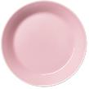
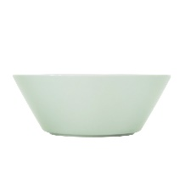
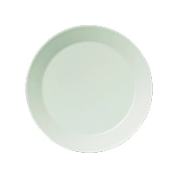

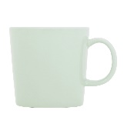

Seasonal*
TEEMA spring-summer edition
DRAFT IMAGES
mug 0,3L
rose
bowl 15cm
rose
plate 17cm
rose
new in rose!
mug 0,3L
light lilac
bowl 15cm
light lilac
plate 17cm
light lilac
mug 0,3L
sage
Bowl 15cm
sage
plate 17cm
sage
Distribution & launch
DTC
*Light lilac 31.1.2025 into continuous collection
Rose & sage 7.3.-31.8.2025 as season´s edition
Tiers 1-3
7.3.2025-30.8.2025 as season's edition
(light lilac is for DTC, but three items in this colour are available in wholeasle as spring-summer seasonal edition)
Forecast deadline for All markets 2nd of June 2024
Basic information
Rose is a re-run from spring-summer 2023 & 2024
rose 17cm plate is new
Light lilac & sage are new colours
Design by Kaj Franck 1952
Loose items
Dishwasher, microwave, freezer and oven safe
Vitroporcelain
Made in Thailand
Remember this:
Teema is an iconic representation of minimalist Finnish design. The soft colour pallet catch the spring and summer season´s mood.
Three eye-catching colours are made to match, but feel free to combine to your own Teema collection, and with other Iittala seasonal news.
Mug, bowl and plate for summer moments: for coffee, ice cream and other sweet or savoury treats.

Slide 6

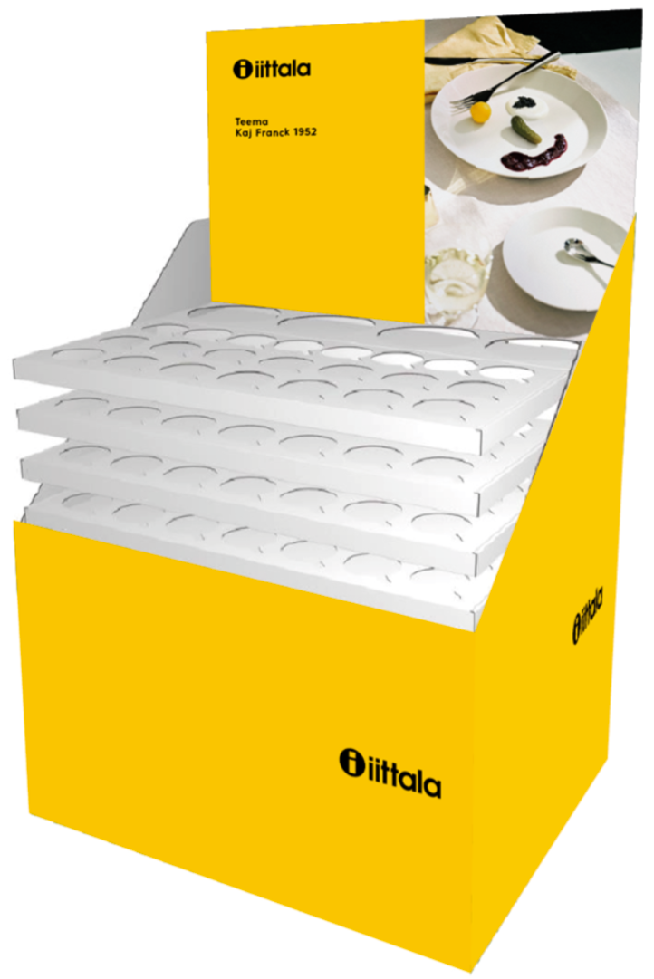

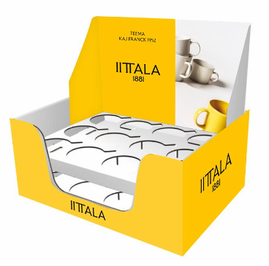


Seasonal
FI only
Tier 3
TEEMA spring-summer edition
DRAFT IMAGES
Display look to be designed for the launch.
Table display
24 mugs, 8 of each
Floor pallet
56 mugs (rose 18, l. lilac 20, sage 18)
24 bowls (8+8+8)
Distribution & launch
Tier 3 – Finland only
7.3.-31.8.2025 as season´s edition
Miminum order quantity total for FI market
Table display 250 pieces
Floor pallet 100 pieces
Forecast deadline for Finland 2nd of June 2024
Basic information
Rose is a re-run from spring-summer 2023 & 2024
Light lilac & sage are new colours
Design by Kaj Franck 1952
Loose items
Dishwasher, microwave, freezer and oven safe
Vitroporcelain
Made in Thailand
Remember this:
Iconic Teema in soft colour pallet catch the spring and summer season´s mood.
Three eye-catching colours are made to match, but feel free to combine to your own Teema collection, and with other Iittala seasonal news.
Bestseller mugs and bowls in in-store displays to maximize visibility and to promote the timely campaign.

Slide 7




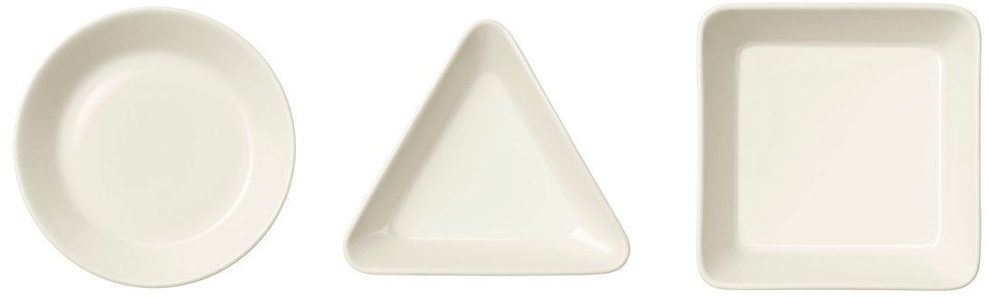



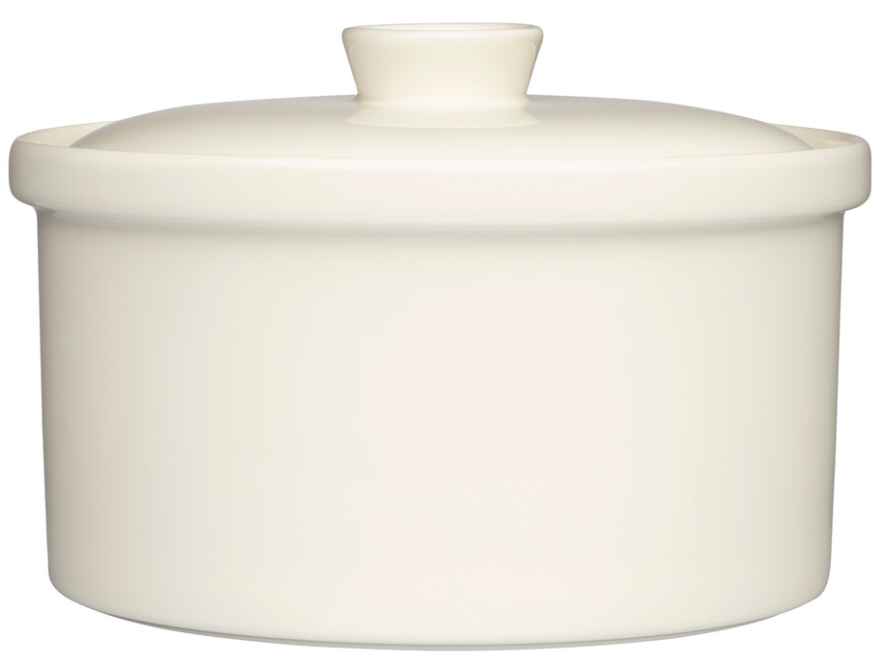





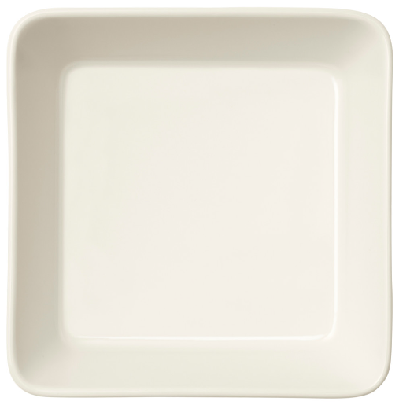


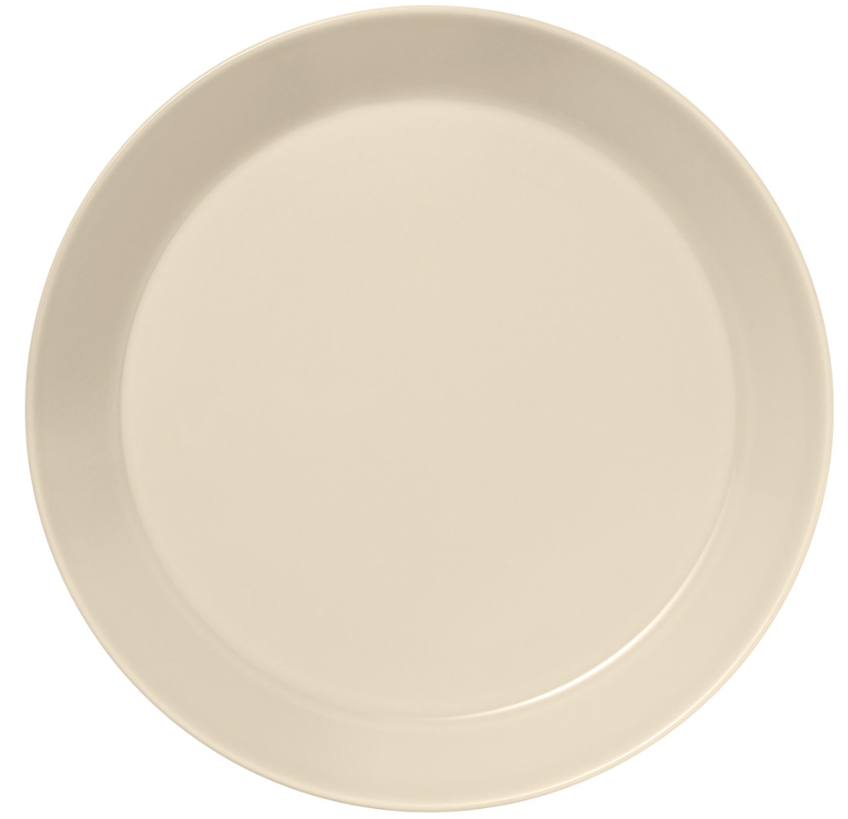
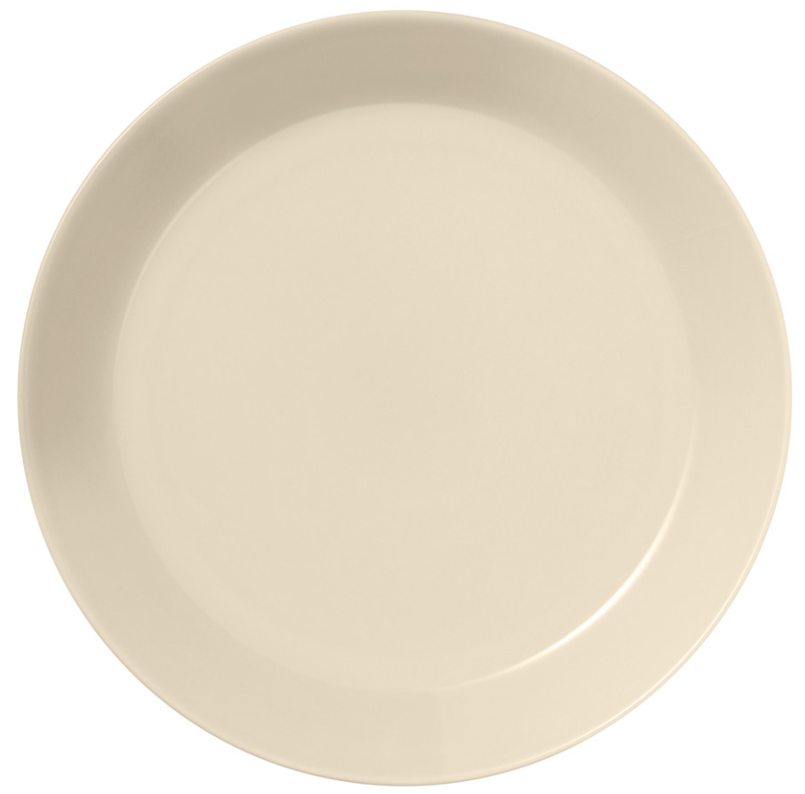
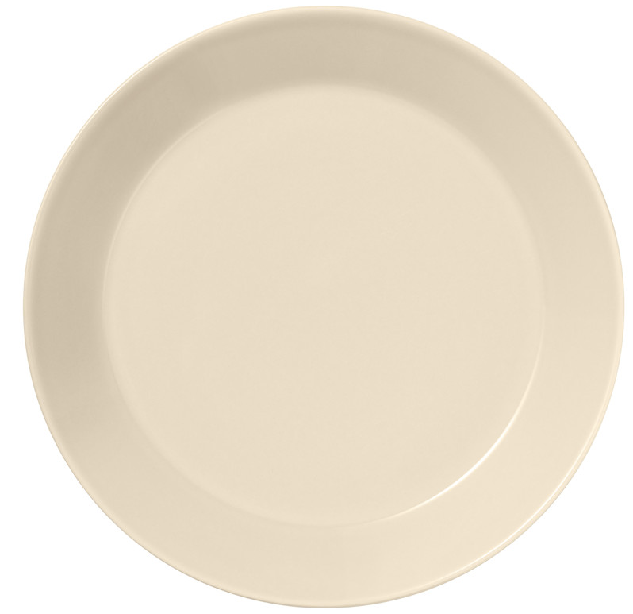
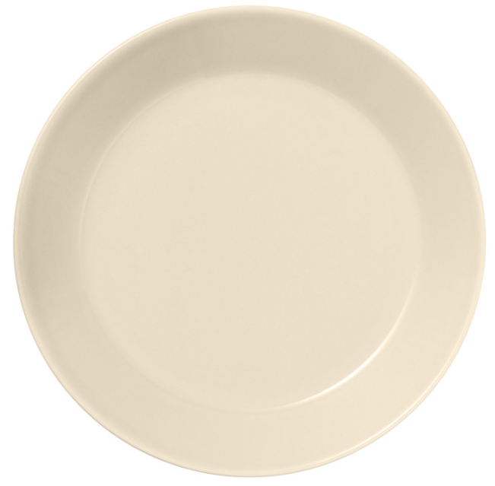
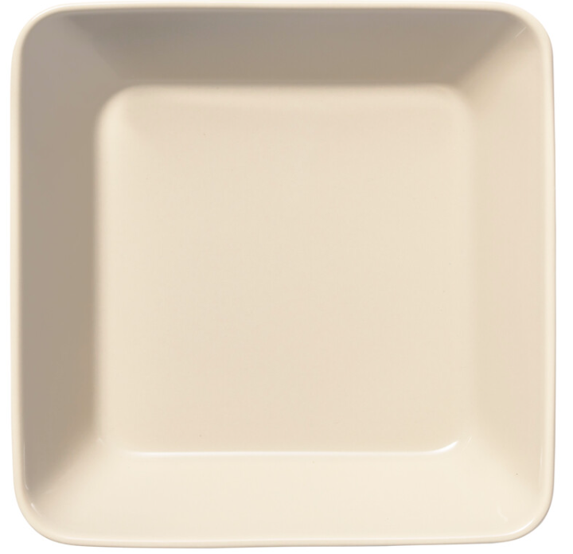
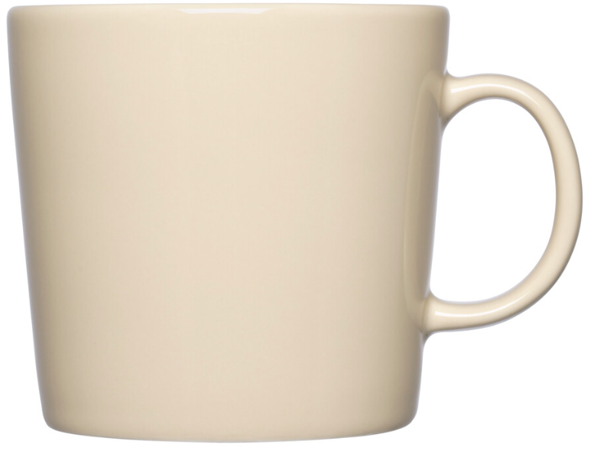
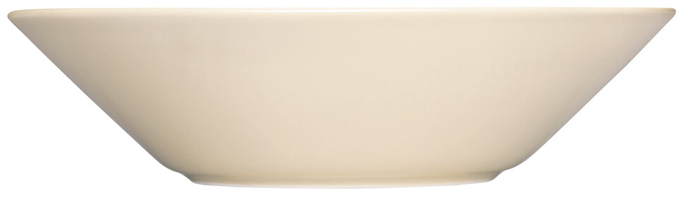
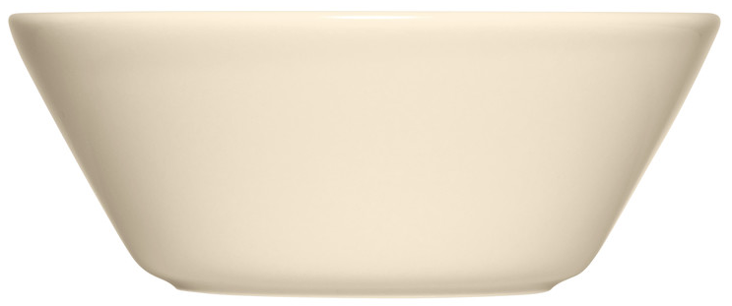
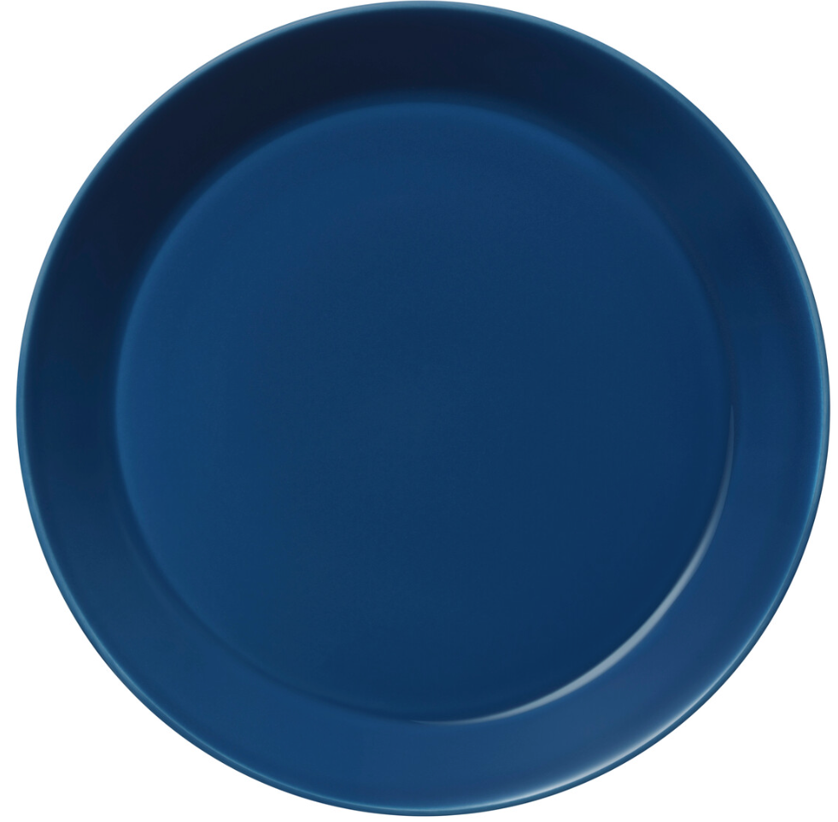
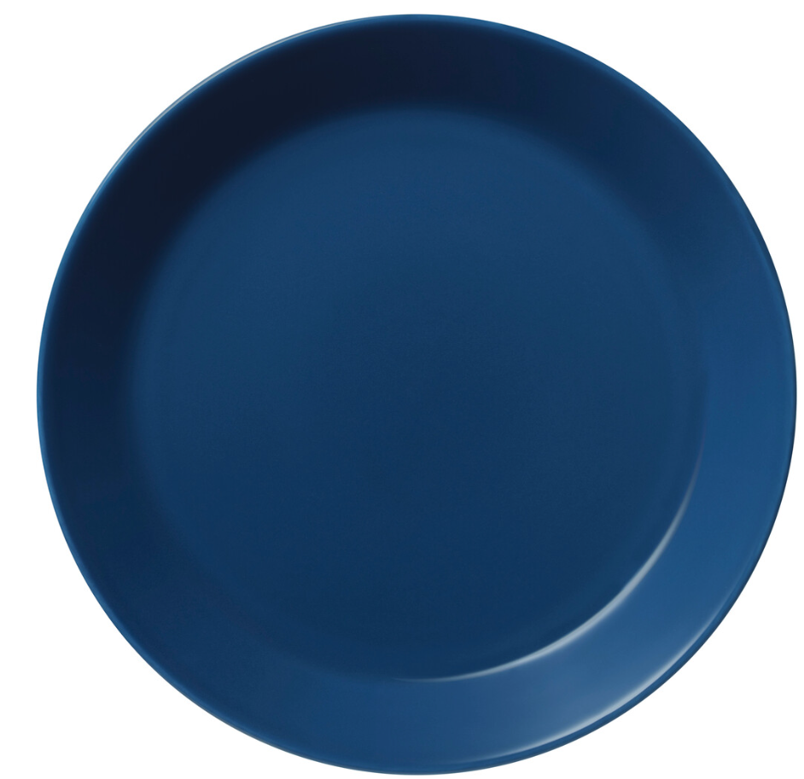
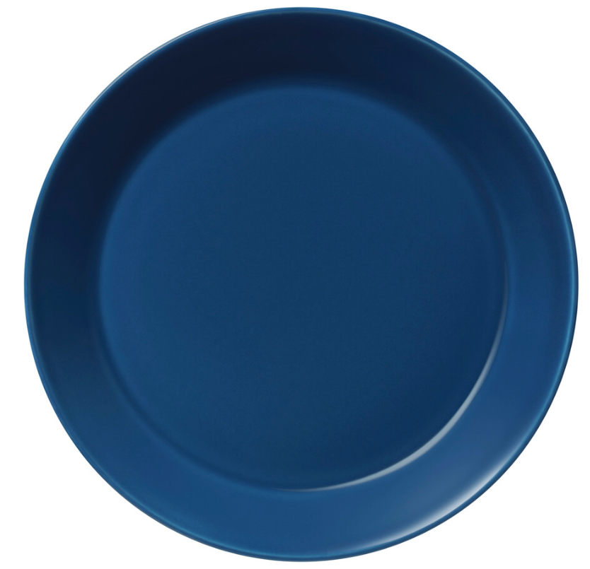
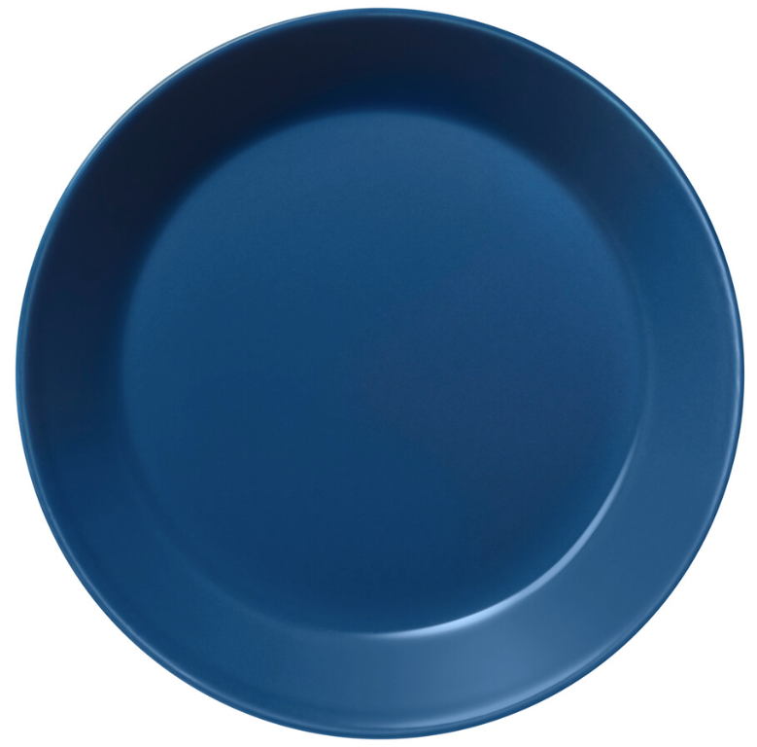

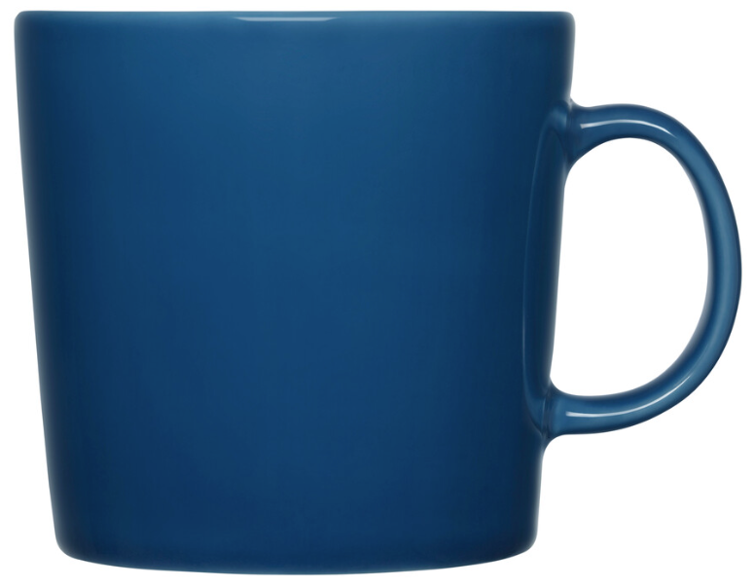
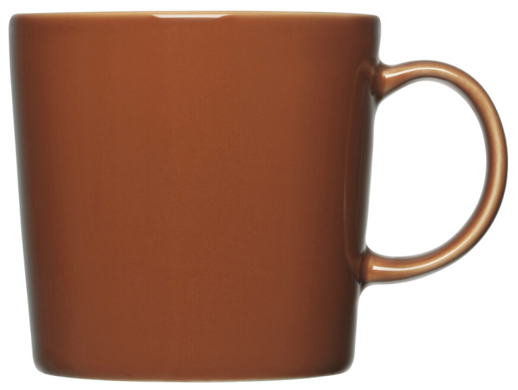
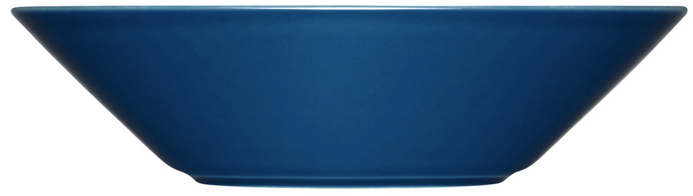
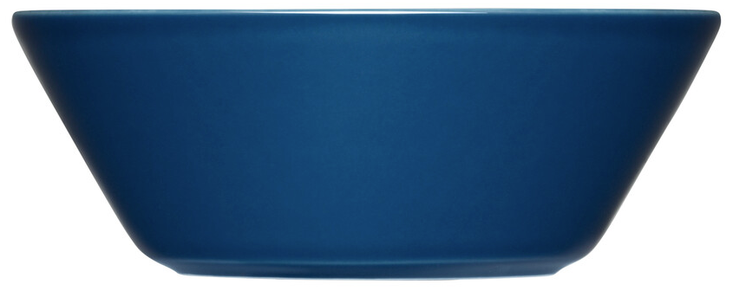
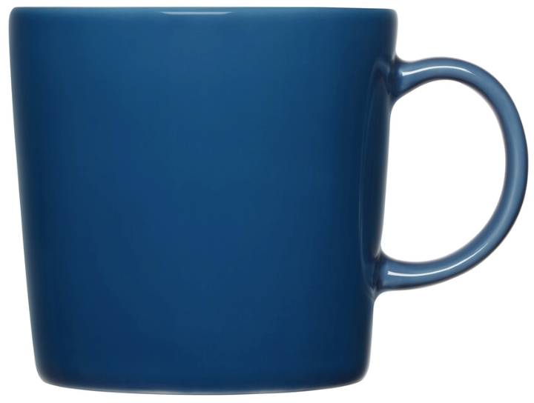










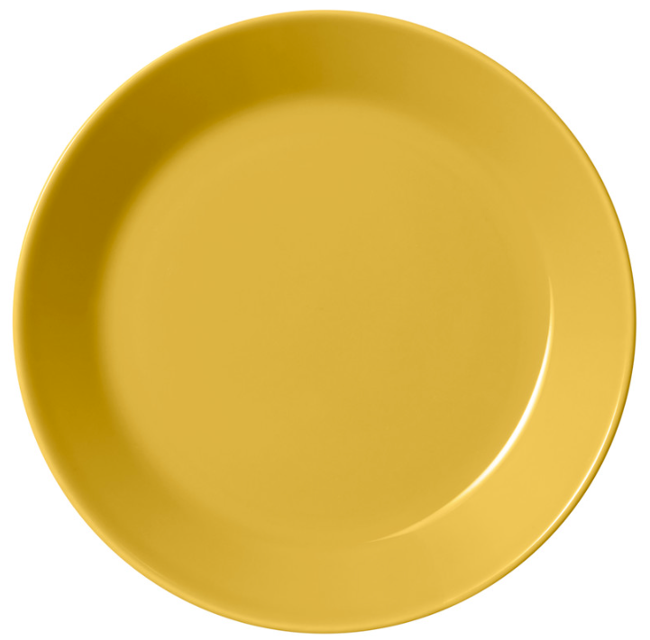



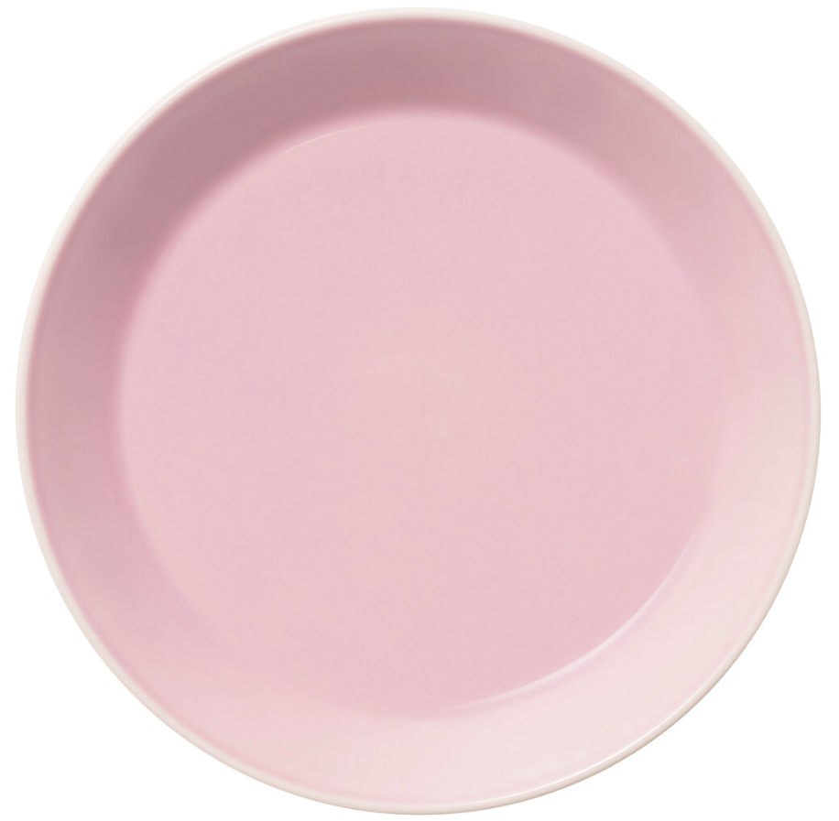
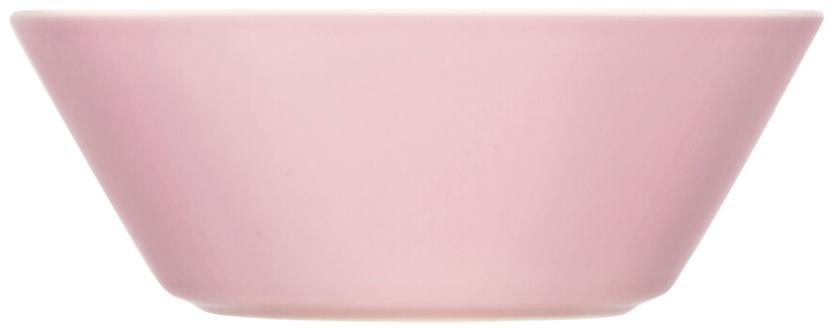
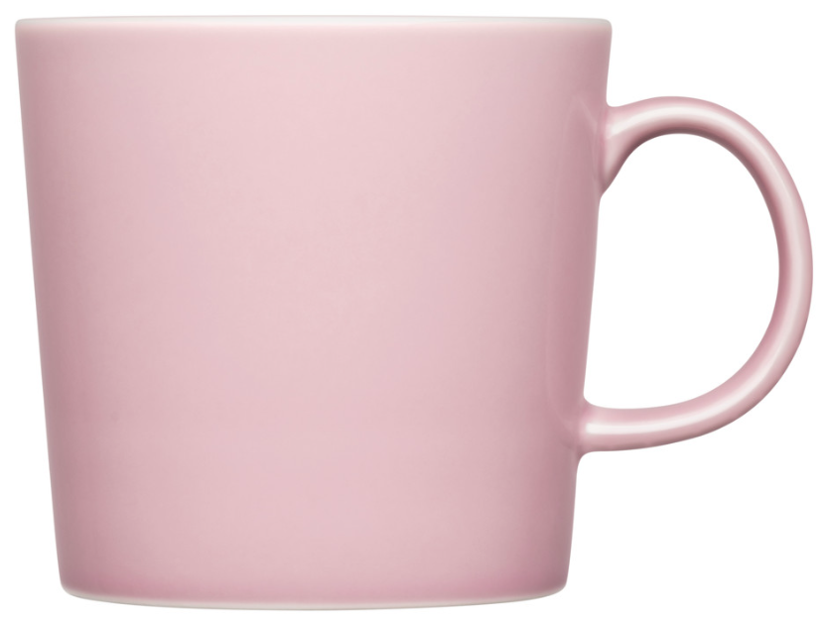
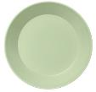
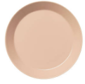
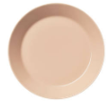




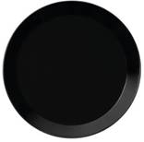
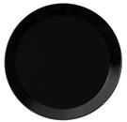
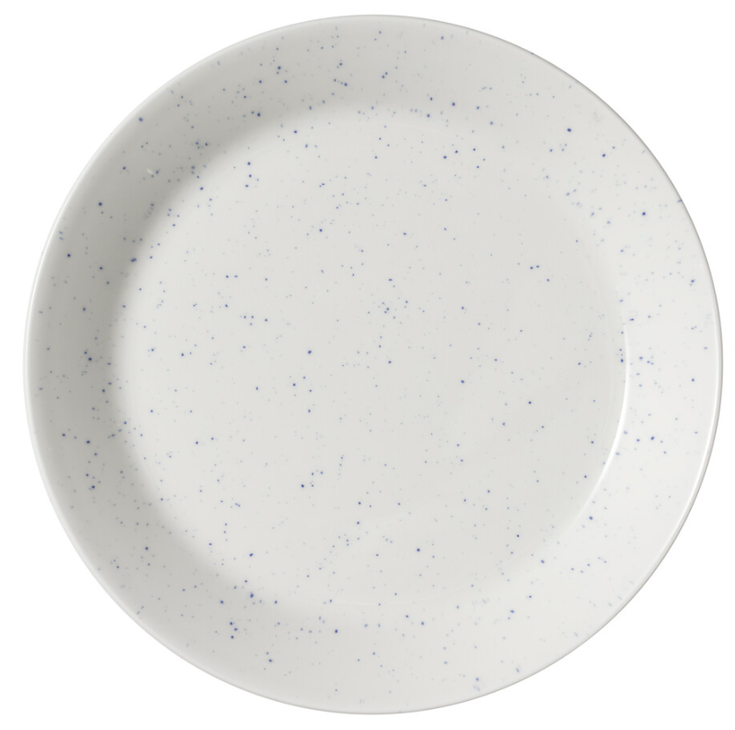
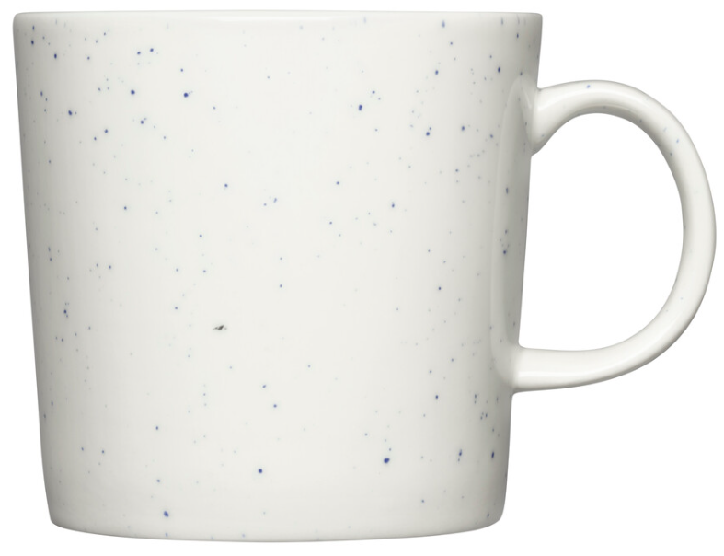
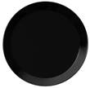


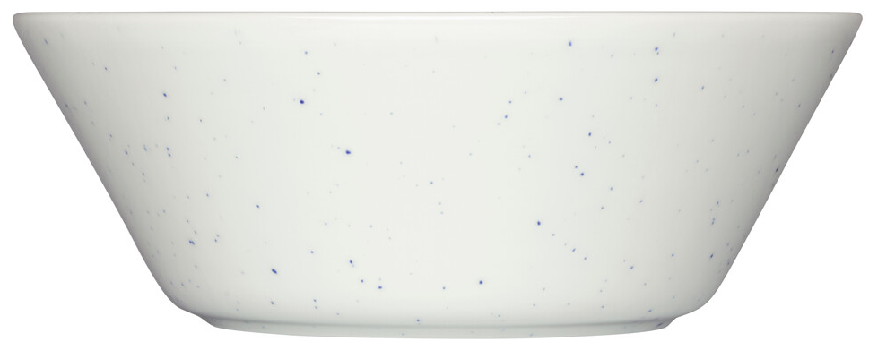


TEEMA
DTC + Tiers 1-3, continuous
white
linen
vintage
blue
vintage
brown
pearl
grey
Seasonal colours SS 2025 seasonal
DTC + tiers 1-3
honey
rose
DTC only, continuous
light lilac
NEW!
light
lilac
sage
NEW!
NEW!
Black: Finland only
DTC + tiers 1-3
powder
recycled

Slide 8
TEEMA BLACK
Finland only
plate 26cm
black
plate 21cm
black
plate 17cm
black
deep plate 21cm
black
bowl 15cm
black
mug 0,3L
black
mug 0,4L
black
Distribution
Teema black becomes part of continuous collection for Finland. Other, please contact Mercandising for campaign use / customer specific opportunities.
Focus in Tier 3
Basic information
Design by Kaj Franck 1952
Loose items
Dishwasher, microwave, freezer and oven safe
Vitroporcelain
Made in Thailand
Remember this:
The versatile Teema collection offers endless combinations that are both durable and refined. Teema is an iconic representation of minimalist Finnish design.
The elegant black colour adds contrast to any table setting and can be mixed and matched with other colours in the Teema collection.

Slide 9
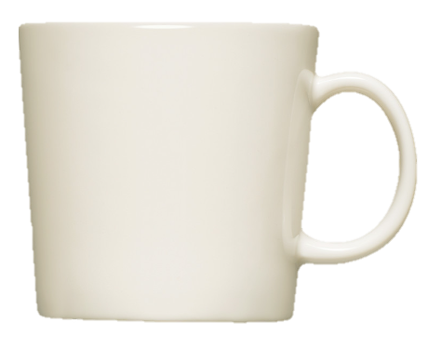
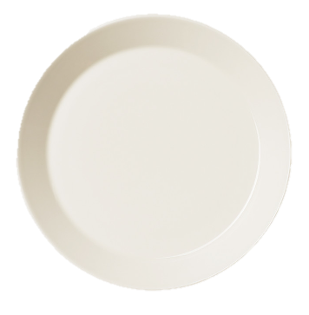
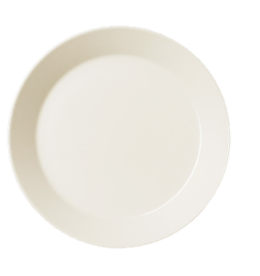








For gifting & campaigns
TEEMA SETS
mug 0,3L 4-set
white
plate 21cm 4-set
white
plate 26cm 4-set
white
serving items 3-set
white
Starter set 8pcs
white
2x plate 21cm & 26cm
2x bowl 15cm & deep plate 21cm
Starter set 16pcs
white
4x plate 21cm & 26cm
4x bowl 15cm & deep plate 21cm
DTC + Tiers 1-3
White in continuous collection.
Sets for other Teema colours for campaigns / custo,
please contact mercandising for MOQ and leadtimes.
Made in Thailand and Romania
Design Kaj Franck 1952

Slide 10

TAIKA

Slide 11

TAIKA
The magical world of Taika has enchanted people around the world with its folkloristic and mystical patterns by Haapaniemi, combined with streamlined shapes of the items designed by Heikki Orvola, since its launch in 2007.
In 2025 Taika range is renewed with a new light lilac colour and celebrated with a spring-summer edition of delicate colours of rose and sage.

Slide 12



Seasonal
TAIKA spring-summer edition
mug 0,4L
rose
mug 0,4L
light lilac
mug 0,4L
sage
Distribution & launch
DTC + Tiers 1-3
7.3-31.8.2025 as season´s edition
Forecast deadline for All markets 2nd of June 2024
Basic information
Rose, light lilac & sage are new colours
Shape design by Heikki Orvola 2006
Pattern design by Klaus Haapaniemi 2007
Loose items
Dishwasher, microwave, freezer and oven safe
Vitroporcelain
Made in Thailand
Remember this:
Designer Klaus Haapaniemi’s lively art and Heikki Orvola’s streamlined design combine to create the unique Taika (‘magic’ in Finnish) collection.
Season´s timely colours: rose, light lilac and pale green sage. The refined colours are made to match, but feel free to combine with other Iittala seasonal news, like with Teema in the same colours.
Generous 0,4L size for latte, iced coffee and tea.

Slide 13



























































TAIKA
black
white
Seasonal colours SS 2025
DTC + tiers 1-3
blue
rose
red
light lilac
sage
DTC + Tiers 1-3
Made in Thailand
Shape design by Heikki Orvola 2006
Pattern design by Klaus Haapaniemi 2007

Slide 14

TAIKA SATO
The story of Iittala’s beloved Taika collection continues with the launch of Taika Sato, collection of tableware and decorative objects. In 2024 launched collection features rich and exquisitely detailed artwork by Taika’s designer, Klaus Haapaniemi. The pattern design in Taika Sato (‘harvest’ in Finnish) showcases fruits and vegetables and continues the distinctive style Haapaniemi is known for.
The rich style of Klaus Haapaniemi's pattern design combined with the streamlined and simplified shapes of the collection's items designed by another Finnish designer, Heikki Orvola, create a timeless and enchanting collection. The shapes of the Taika Sato vases and jars are designed by Haapaniemi himself.
In 2025 Taika Sato range is extended with two new mugs with rich earthy yellow pattern.

Slide 15


TAIKA SATO
mug 0,4L
yellow
mug 0,3L
yellow
Distribution & launch
DTC
Pre-launch AW 2024 20.9.2024 into continuous collection
Tier 1-3
3.1.2025 into continuous collection
Forecast deadline for All markets 2nd of June 2024
Basic information
New pattern to Taika Sato mugs
Shape design by Heikki Orvola 2006
Pattern design by Klaus Haapaniemi 2024
Loose items
Dishwasher, microwave, freezer and oven safe
Vitroporcelain
Made in Thailand
Remember this:
The Sato pattern design in Taika Sato (‘harvest’ in Finnish) showcases fruits and vegetables and continues the distinctive style Haapaniemi is known for.
New mugs in earthy yellow colour with pink highlights. Same pattern as in the rectangle and square plates in the collection. Combine with your Taika Sato set or add as a patterned detail with your Teema collection.
The 0,3L mug for hot drinks. The popular mug size also available in the Taika Sato and Taika collections. Large 0,4L size for long coffee drinks and tea.

Slide 16





























TAIKA SATO
DTC + Tiers 1-3
Except for Interior items DTC + Tier 1-2
Taika Sato yellow mugs DTC pre-launct AW 2024,
wholesale launch January 2025
Ceramics made in Thailand
Napkins made in Finland
Teatowels made in Lithuania
Shape design by Heikki Orvola 2006
Pattern design by Klaus Haapaniemi 2024
Vases & jars shape & pattern by Klaus Haapaniemi 2024

Slide 17

PLAY
Play is a collection of home items that are easy to mix and match. It's a collection of functional items one can play with in the table setting and decor. The warm colours glowing in the sun and Matisse's cut-out art inspired the collection. The collection focuses on the art of craft, material expression, bold colour combinations and a playful mix of shapes.

Slide 18






S1 2025 PLAY TIER 2-3 EXPANSION
mug
0,35L
Glass vase 180mm
NEW!
Papernapkins
33x33cm
Distribution & launch
In March 2024 Launched with selected DTC + Tier 1
In August 2024 extended launch to all DTC + Tier 1
Next, from 7.3.2025 extended launch, selected items for Tier 2-3
continuous collection
changes:
selected items also for tiers 2-3
Forecast deadline for All markets 2nd of June 2024.
Basic information
Ceramics
designed by Aleksi Kuokka 2024
loose items
Vitro porcelain
Dishwasher, microwave, freezer and oven safe
Made in Thailand
Basic information
Glass
Designed by Anne Hirvonen 2024
Iittala yellow consumer package
Mouth blown glass
Handwash only
Made in Finland
Basic information
napkins
Iittala design
Paper, food safe colours​
General size for any occation​
Made in Finland

Slide 19




































PLAY per Tiers from 7.3.2025
NEW!
NEW!
NEW!
DTC only
pink-orange textiles and bowl 9cm + 19cm to be delisted, thus not extended for Tier 1 like other pink-orange
DTC + Tiers 1
DTC + Tiers 2-3

Slide 20
PAINTING
THE WORLD
WITH THE COLOURS
OF GLASS.

Slide 21

TUNDRA

Slide 22

TUNDRA
Designed by Oiva Toikka, Tundra series is inspired by the far Northern hemisphere, with patterns deducted of Tundra nature. Within the full tundra pattern, there are up to 12 small detailed patterns.
In these, we can see inspiration from mosses, shrubs, sedges and lichens that cover the plains of Lapland.
The series was produced at Nuutajärvi glassworks only a short time, 1970-71. In 2023 Iittala brought the Tundra range back to the continuous collection. The harmonious Nordic nature inspired colour pallet in Tundra range enable beautiful settings.
In 2025 the series is extended to a new fresh aqua blue colour.

Slide 23





TUNDRA aqua
DRAFT IMAGES
tumbler 29cl aqua 2pc
tumbler 16cl aqua 2pc
plate 154mm aqua
bowl 25cl
aqua
bowl 62cl
aqua
Distribution & launch
DTC + Tiers 1-2
3.1.2025 into continuous collection
Forecast deadline for All markets 2nd of June 2024
Basic information
Aqua is new colour to Tundra collection
Design by Oiva Toikka in 1970
Tumblers in 2pc Iittala standard package
Bowl 62cl in 1pc Iittala standard package
Plate and bowl 25cl loose items
Dishwasher safe
Pressed glass
Made in Finland
Remember this:
The harmonious Nordic nature inspired colour pallet in Tundra range enable beautiful settings. The fascinating details of the pattern bring a piece of the far Northern hemisphere into the everyday life.
The 29cl Tundra tumbler is perfect for water, juice and cocktails whereas the smaller one is for fresh juice, water and small drinks. Use the small bowl for starters, desserts or at breakfast, and the plate for cold meals and serving. The large bowl is a versatile and always useful generous size fit for dining and serving.

Slide 24






















TUNDRA
4-sets, clear
clear
aqua NEW!
linen
pine green
Clear sets in continuous collection.
Sets for other colours for campaigns / custo,
please contact mercandising for MOQ and leadtimes.
calluna
DTC + Tiers 1-2
Made in Finland
Design Oiva Toikka 1970

Slide 25

KARTIO

Slide 26

KARTIO
Known as the conscience of Finnish design, Kaj Frank sought to remove excess in his work leaving only the essentials. In 1958, Franck realized his goal with the Kartio glass, which captured the perfect balance between material and geometric form.
Simple, yet durable enough for everyday use, Franck mastered the creation of the basic drinking glass, which is a legendary design beyond any trend. The wide and versatile colour palette of Kartio perfectly represents Iittala’s knowledge of coloured glass.
In 2025 the series is extended with a re-launch of the sweet apple green colour.

Slide 27


Seasonal
KARTIO apple green spring summer edition
tumbler 40cl
apple green
tumbler 21cl
apple green
Distribution & launch
DTC + Tiers 1-3
7.3.-31.8.2025 as season´s edition
Forecast deadline for All markets 2nd of June 2024
Basic information
Re-launch of apple green (earlier 2009-2018)
Design by Kaj Franck 1958
2pc Iittala standard package
Dishwasher safe
Pressed glass
Made in Finland
Remember this:
Designer Kaj Franck sought to remove excess in his work leaving only the essentials. In 1958, Franck realized his goal with the Kartio glass, which captured the perfect balance between material and geometric form. ​
​
Simple, yet durable enough for everyday use. The sweet apple green pops out from table settings. Combine with Iittala´s spring-summer specials or add as a colour effect to your existing Iittala collection. Available for spring-summer season in 2025.​

Slide 28
















KARTIO
clear
aqua
water
green
apple
green
NEW!
season´s edition
pine
green
calluna
linen
dark
grey
4-set & 6-set, clear
Sets for other colours for campaigns / custo,
please contact mercandising for MOQ and leadtimes.
DTC + Tiers 1-3
Made in Finland
Design Kaj Franck 1958

Slide 29

TEALIGHT CANDLEHOLDERS

Slide 30

KASTEHELMI
Kastehelmi (“dewdrop” in Finnish) draws inspiration from dewdrops glistening like a string of pearls under the morning sun and refers to the circles of delicate bubbles in the pressed glass that give each piece in the collection its distinct character. Originally designed by Oiva Toikka in 1964, the Kastehelmi series was relaunched in 2010.
Toikka came up with the idea to use droplets of glass as decoration when trying to find a way to hide joint marks left in the production process. The result was a unique design that features rings of tiny glass bubbles that extend outwards from the center of each piece. The droplet enhanced the optical quality of Iittala’s glass recipe resulting in a glass that is like no other. For over fifty years, Kastehelmi has been a beloved Iittala series.
In 2025, the Kastehelmi tealight candleholders colour pallet are extended with candy-like sweet apple green and fresh aqua.

Slide 31


seasonal
apple green
KASTEHELMI tealight candleholders
tealight candleholder
64mm apple green
tealight candleholder
64mm aqua
Distribution & launch
DTC + Tiers 1-3
Aqua 3.1.2025 into continuous collection
Apple green 7.3.-31.8.2025 as season´s edition
Forecast deadline for All markets 2nd of June 2024
Information
Re-launch of apple green (earlier 2012-2018)
Re-launch of aqua (earlier 2017- 2018)
Design by Oiva Toikka
Iittala standard package
Handwash only
Pressed glass
Made in Finland
Remember this:
Designed by artist Oiva Toikka.
Inspired by nature, Kastehelmi draws inspiration from the calm morning moment when the night dew has left all the leaves full of brilliant little pearls.
The Kastehelmi tealight candleholder collection features a wide range of colours. The glowing colours in glass create a striking eye-catcher in any interior. Season´s new colours are thoughtful hostess gifts, or for any occation.

Slide 32





KIVI
Kivi (meaning “stone” in Finnish) are small jewels of light designed by Professor Heikki Orvola in 1988. It is a modern classic of Finnish design. Kivi’s thick glass enriches the flame, creating a gentle glow that brings warm ambience to any interior. Each hue is created using Iittala’s own personalized colour recipe using solid colour for the glass mass instead of merely colouring the glass from the surface which makes the colour especially rich. Kivi is available in several different colours.
In 2025, the Kivi range is extended with several beautiful colours.

Slide 33




seasonal
apple green
KIVI tealight candleholders
tealight candleholder
60mm apple green
tealight candleholder
60mm aqua
tealight candleholder
60mm pine green
tealight candleholder
60mm pine green
tealight candleholder
60mm linen
Distribution & launch
DTC + Tiers 1-3
3.1.2025 into continuous collection
except for apple green as season´s edition 7.3.-31.8.2025
Forecast deadline for All markets 2nd of June 2024
Note! Linen colour will be pre-launched AW24 in Finland only in the DTC channel and as customer specific.
Basic information
Re-launch of apple green (earlier 2012-2018)
Re-launch of aqua (earlier 2017-2018)
Pine green in 2024 (special edition)
Calluna in 2023 (special edition)
Linen in 2021 (Japan edition)
Design by Heikki Orvola in 1988
Iittala standard package
Handwash only
Pressed glass
Made in Finland
Remember this:
Kivi (’stone’ in Finnish) tealight candleholders were designed by Heikki Orvola in 1988. The small jewels of light come in a vast multicolour dream of rich shades that perfectly showcase Iittala’s unique coloured glass expertise.
Kivi’s thick glass enriches the flame, creating a gentle glow that brings warm ambience to any interior.
Create a set with your favourite colours for striking impact. The seasons new colours are thoughtful gifts.

Slide 34




















TEALIGHT CANDLEHOLDERS
KIVI
KASTEHELMI
VALKEA
ULTIMA THULE
clear
frosted
clear
aqua
NEW!
water
green
apple
green
NEW!
season´s edition
pine
green
calluna
linen
grey
DTC + Tiers 1-3
Made in Finland
Kivi design Heikki Orvola 1988
Kastehelmi design Oiva Toikka 2010
(tealight candleholders)

Slide 35




For gifting and season´s home decoration
Glass accessories
Iittala mini glass birds
yellow 3-set
Iittala mini glass birds
pink 3set
Iittala glass eggs
spring 3-set
Iittala glass eggs
mix 3-set
Distribution & launch
Mini glass birds
DTC + Tiers 1-2
7.3.-31.8.2025 as re-run for season´s edition
Mini glass egs
DTC + Tiers 1-3
already in the continuous collection
Forecast deadline for All markets 2nd of June 2024
Basic information
Mini birds based on Flycatcher design by Oiva Toikka
Iittala standard package
Wipe with damp cloth
Mouthblown glass
Made in China
Remember this:
Iittala´s glass ornament sets let you add festive detail to the holidays. The bright and vibrant colours reflects light beautifully.
The cute mini glass birds are inspired by the Flycatcher art glass birds designed by glass artist and designer Oiva Toikka in the early 1970´s. The birds and glass eggs are timely decorations in the spring. Packed in 3-sets in a gift box that will serve as a package to keep the items from season to season.
Hang the ornaments beautifully on branches in a vase or use them to create a joyful atmosphere elsewhere in your home. A mouth blown glass ornament set makes a memorable gift.

Slide 36



Seasonal
Spring summer editions
summary
Kartio
apple green
tealight candleholders
apple green
Taika mug 0,4L
rose, light lilac & sage
Teema mug 0,3L
rose, light lilac, sage
(light lilac conti in the DTC)
Iittala mini glass birds
yellow 3-set
Iittala mini glass birds
pink 3set
Distribution & launch
DTC + Tiers 1-3
Kartio, Kastehelmi, Kivi, Taika, Teema
7.3.2025-31.8.2025 (Teema light lilac DTC launch 31.1.2025)
DTC + Tiers 1-2
Mini glass birds 7.3.2025-31.8.2025 (re-run from spring-summer 2024)
Forecast deadline for All markets 2nd of June 2024

Slide 37
THANK YOU

